Slide 1
Nail disorders

Slide 3
Nail changes in skin diseases
1- psoriasis:
10-50% of psoriasis have nail involvement
A- pitting : ice-pick depressions in nail plate
other causes: normal finding
alopecia areata
B- onycholysis: separation of nail plate from its bed
other causes:-skin diseases: fungal infection,
eczema

Slide 4
- general medical diseases: hypo & hyperthyroidism
- trauma: house wives
- drugs: tetracyclin, PUVA- therapy
C- subungual hyperkeratosis: thickening of nail bed, distorted & separated nail plate

Slide 5
2-Lichen planus:
10% have nail changes
a- thinning of nail plate & longitudinal ridging
b- pterygium: adhesion & fusion of proximal nail fold with nail bed due to destruction of nail matrix

Slide 6
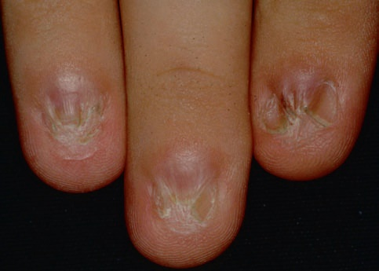

Slide 7
Nail infections
1- acute paronychia:
Sudden painful red swelling of nail fold with accummlation of pus behind cuticle, usually due to staphylococci, but other bacteria like strepto. pseudomonas, G-ve bacteria may be involved.
Treat: drain pus + topical & systemic antibiotics

Slide 9
2- chronic paronychia:
Common in house wives, insidious mild pain & swelling of nail folds, mostly due to candidal infection. Acute exacerbation may occur due to secondary bacterial infection.
Patho: on repeated exposure of the fingers to moisture the cuticle is lost leaving space between proximal nail fold & nail plate which is easily contaminated with Candida.

Slide 10
The nail folds are red , swollen & tender, the cuticle is absent , nail plate are deformed & thickened.
Treat: keep fingers dry, wear cotton gloves under rubber glove .
topical antifungal lotion, systemic antifungal
( fluconazole 150-300mg/wk)

Slide 12
2- Dermatophyte infection( onychomycosis)
Tinea unguun
3-Viral infection:
a- wart: periungual, common in children& nail bitters, it may involve nail folds or finger tips
b- Herpetic whitlow: herpes simplex infection of finger tips, painful grouped vesicles( honey comb appearance.

Slide 13
Ingrowing toe nail
Common , big toe is most ferquently affected
The nail plate pierces lateral nail folds & entering dermis causing pain & swelling of nail folds, secondary bact infection may occur lead to pus formation & over growth of granulation tissue.
Lateral pressure by tight shoes with excessive cutting of lateral part of nail plate are predisposing factors.
Treat:cutting & removal of pentrant part of nail
destruction of lateral part of nail matrix with phenol 80% application

Slide 14
Nail changes in systemic diseases
1- Beau s lines:
Transverse depression of nail plates, it seen few weeks after stressful conditions such as fever, measles, pneumonia,DM..etc.
The lines progress distally with normal growth of nail

Slide 15
2- clubbing of fingers:
distal phalanges are enlarged,bulbous in shape,
Nail plate is curved, obliteration of the angle made by proximal nail fold &nail plates.
It is irreversable, associated with ch lung diseases, CV diseases, cirrhosis, thyroid diseases, colitis & may be seen in normal peoples

Slide 17
3- Terry s nail:
the nails are white at proximal 2 thirds & normal pink distal third of nail beds.
It is found in ch renal failure, congestive heart failure, DM, ageing.
Half & half nail : proximal white half & distal pink half, seen in ch renal failure

Slide 18
3- spoon nail (koilonychia):
central depression of nail plates with elevation of lateral parts ( spoon shape ). , reversable
seen in normal children, iron deficiency anemia,
Hemachromatosis

Slide 19
5- yellow nail syndrome:
nail slow to grow or even stop to grow, nail plate thickened & become dark yellow, the cuticle & lunulae are lost .
Associated with ch lymphodema of limbs, pleural effusion, bronchiectasis, ch bronchitis

